Slide 1
Index Function
Presented By: Rahul Sutar

Slide 2
Index Function: -
The Index function returns a value or the reference to a value from within a table or range.
Syntax: -
=INDEX(array,row_num,col_num)
array- A range of cells, or an array constants
row_num- The row position in the reference or array.
col_num- The row position in the reference or array.

Slide 3
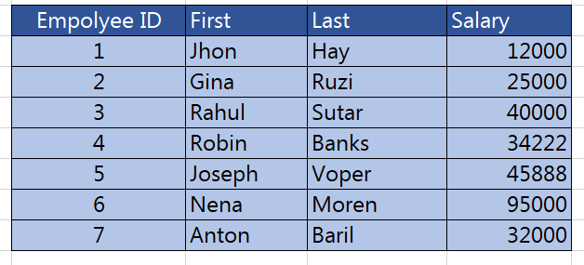

Example: -
Find the employee salary from First name.

Slide 4


Thank You
Any Questions

